Slide 1
WalkMe Strategy & Value Framework
A systematic and repeatable four-step approach to aligning business value — from vision to post-deployment of Digital Adoption across the enterprise — focused on strategic priorities and maximizing the quantitative and qualitative return on investment.
The 4 P’s of digital adoption strategy and value
1
Problem you are trying to solve
2
Possible strategic outcomes
3
Probable DAP value
4
Provable value realized
Vision
&
Strategy
Challenges
&
Objectives
Problem
Identify key organizational priorities and targets, line of business issues, and process & technology problems.
Possible
Explore the outcomes, scope the focus areas, demo and identify options for innovation.
Why, Who, How, When?
Discuss & Demo WalkMe Outcomes
Do you have a Solution?
Probable
Define the future business outcomes and target benefit of WalkMe. Summarize ROI and the value story in the business case.
Value
Hypothesis or
Assessment
Implement
Measure
Mature
Provable
Baseline your as-is business process KPIs, enable analytics, measure the success of your implementation, execute value checkpoints.
Value
Realization
running footer with “Learn more” and a link to walkme.com

Slide 2
Know your target audience
Know your audience
Recognize that value differs by persona. The “what’s in it for me?” changes based someone’s role within the organization.
Locate the stakeholders for your program on this pyramid, and be hyper-focused on what outcomes, types of metrics, and which KPIs matter most to them.
Role
Enterprise Execs
Ownership
Strategy
Line of Business Leaders
Tactics
Application and Service Owners
Operations
Ownership | Expected value | Sample metrics
Strategy | Executive metrics reveal how the organization is performing over time and if strategic objectives will be met. | Operational benefits Customer benefits Enterprise benefits
Tactics | Leaders use these metrics to support process improvement decisions and measure business outcomes. | Cost effectiveness Revenue generation Risk & compliance Digital user satisfaction Productivity Cycle time Process efficiency
Operations | Managers rely on operational KPIs to measure the progress of initiatives. | Shortened average lead time Greater up-sells and cross-sells Improved compliance pass/fail Improved process conformance Improved quality of product
running footer with “Learn more” and a link to walkme.com

Slide 3
Problem — Align to the business
Identify your mission and goals, what you’re trying to solve, and company priorities. What are the desired outcomes?
Strategic Drivers & Initiatives
Operational Challenges & Objectives
WalkMe Solution & Value Drivers
Outcomes & User Workflows
Value Hypothesis
Strategic Initiative #1
HR
Process Efficiencies
HR
HR
HR Objective #1
Cycle Time
HR User Workflow #1
HR Value #1
Strategic Initiative #2
HR Objective #2
Productivity
HR User Workflow #2
HR Value #2
Strategic Initiative #3
Cost Effectiveness
Strategic Initiative #4
CUST SERV
Revenue Generation
CUST SERV
CUST SERV
Cust Serv Objective #1
Risk and Compliance
Cust Serv User Workflow #1
Cust Serv Value #1
Strategic Initiative #5
Cust Serv Objective #2
Digital User Satisfaction
Cust Serv Custom Outcome #2
Cust Serv Value #2
Connect your digital adoption strategy to existing initiatives within your organization, and identify which value drivers are most relevant to your stakeholders. Depending on department and initiative, the solutions that provide the most value can be very different.
Strategic Drivers & Initiatives
Operational Challenges & Objectives
WalkMe Solution & Value Drivers
Outcomes & User Workflows
Value Hypothesis
Strategic Initiative #1
HR
Process Efficiencies
HR
HR
HR Objective #1
Cycle Time
HR PBO #1
HR Value #1
Strategic Initiative #2
HR Objective #2
Productivity
HR User Workflow #2
HR Value #2
Strategic Initiative #3
Cost Effectiveness
Strategic Initiative #4
CUST SERV
Revenue Generation
CUST SERV
CUST SERV
Cust Serv Objective #1
Risk and Compliance
Cust Serv PBO #1
Cust Serv Value #1
Strategic Initiative #5
Cust Serv Objective #2
Digital User Satisfaction
Cust Serv PBO #2
Cust Serv Value #2
Look for opportunities to bring business and technical value on multiple levels for each initiative.
running footer with “Learn more” and a link to walkme.com

Slide 4
Possible — Blueprint ideas and business value
Identify what you want to achieve and how you’ll do it. Explore different solutions that WalkMe offers for solving your business problem. Identify if your solution can be done in phases such as crawl, walk, run within the given timeframe. Create demos and show people the possibilities. Identify the business metrics (KPIs) that can be used to baseline and measure success.
Department | Challenges | Use cases & capabilities | Workflows | KPIs
Human Resources | Infrequent process Frustrating manager and employee experience | Accessible walkthroughs with guidance and annual process updates Cross-application integration shuttles and validation tips for managers In-form templates with launchers, tips, field validation, and automation for consistency | Performance Management Annual Benefits Enrollment | On-time completion Reduced escalations Reduced exception cycle time
 | Poor experience Multiple tools Delay in staff productivity | Checklists for new hire, job change, onboarding In-app guidance and notification for managers and employees Navigation and form automation within the system and shuttles with automation across systems to reduce complexity and time | New Hire Management Employee Onboarding Recruiting | Improve employee experience Reduced cost to support process Improve cycle time
Customer Service | Lack of behavior insights Lack of self-service adoption User frustration | Customer self-service experience analytics Improve customer compliance with tips and walkthroughs Customer segmentation with launchers and app shuttles | Self Service Portal Management Case Management | Higher CSAT Decreased abandon rate Higher self-service completion rate
 | High volume of work Too many segments by product, customer loyalty, and geography | Dynamic guidance based on segments for agents Integrated across systems within process for agents Ease site navigation for customers Integration of customer information, company policies, and other factors needed in-process at the time of support | Customer Support Warranty Management Rebate Management | Higher CSAT Reduced cost to support Improved process compliance Reduced time to completion
running footer with “Learn more” and a link to walkme.com

Slide 5
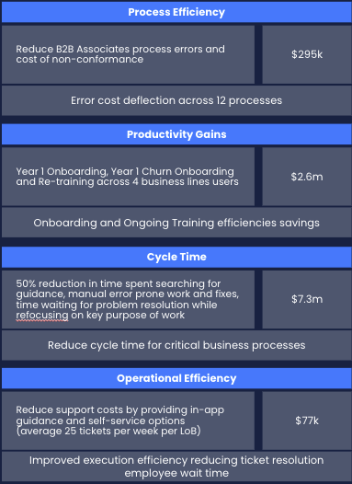
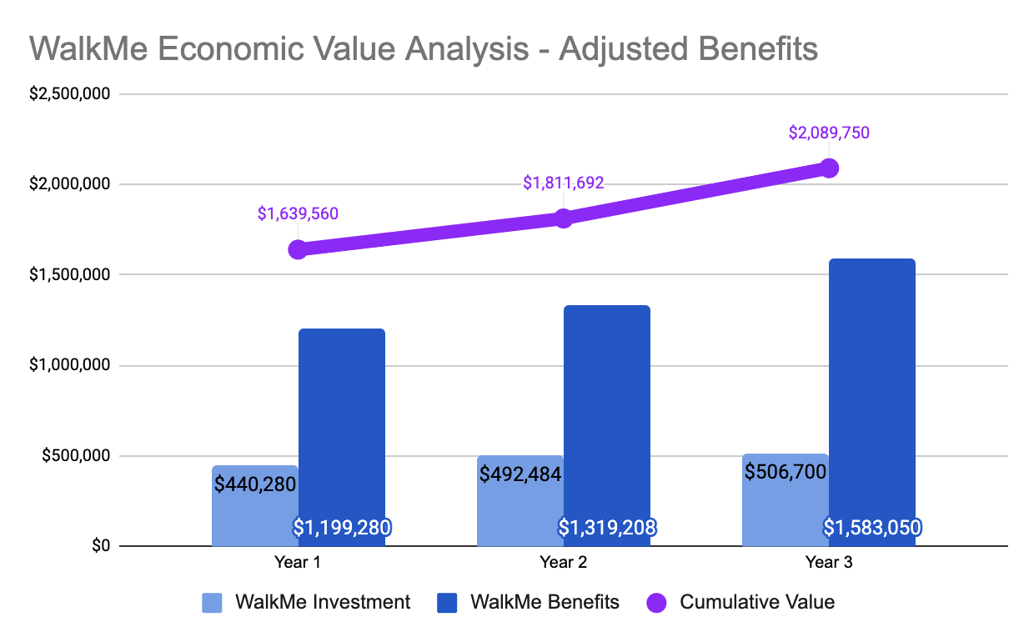
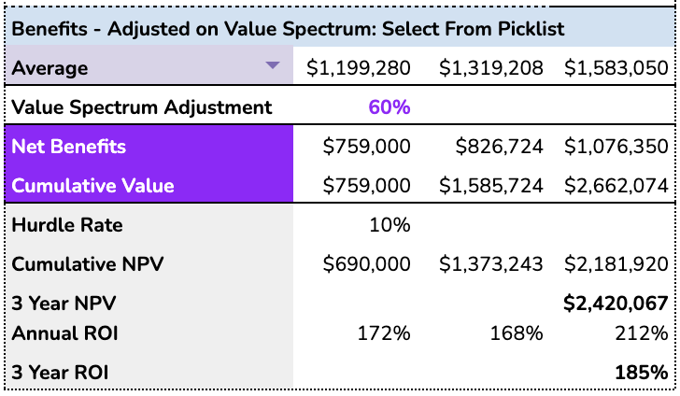
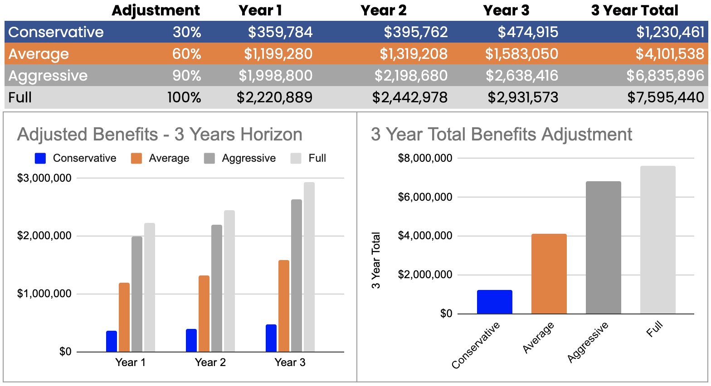
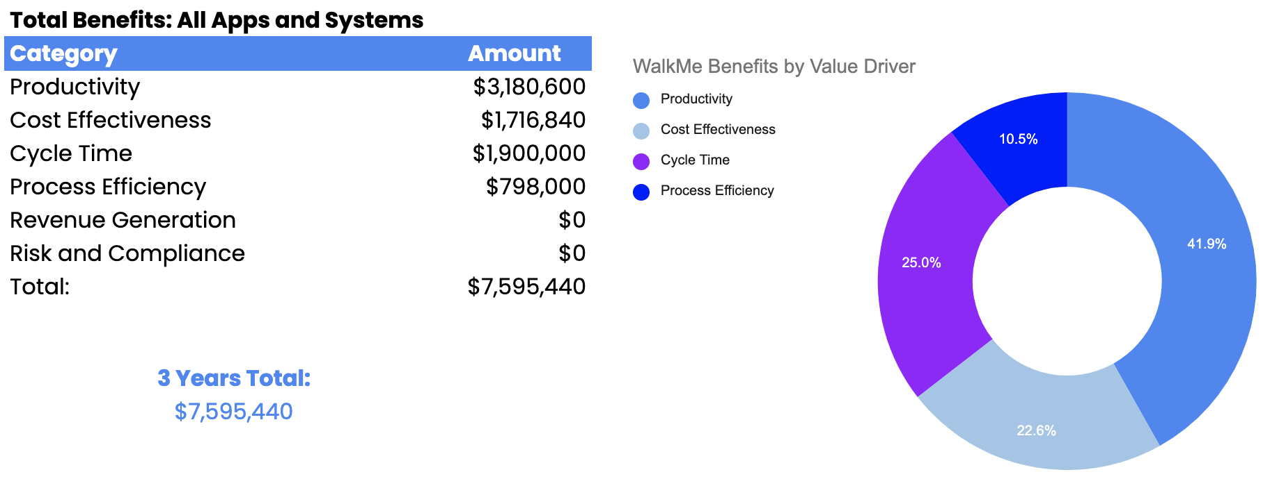
Probable — Calculate the target benefits and ROI
Identify the target value you hope to achieve using common benefits that can be found from WalkMe benchmarks, IDC, Forrester, or similar use cases. What is the probable benefit of what you’re proposing? Review with your stakeholders.
Process Efficiency
Productivity Gains
Cycle Time
Cost Savings
running footer with “Learn more” and a link to walkme.com

Slide 6
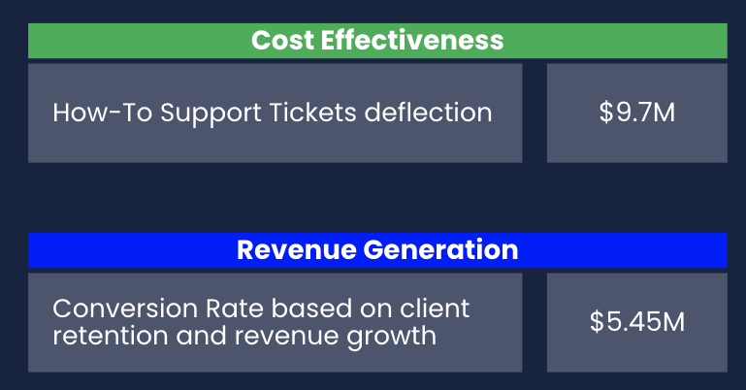
Provable — Measure ongoing success
Baseline, baseline, baseline. Implement, measure, and mature. Use analytics and cost analysis to demonstrate the value delivered. Include regular value checks to monitor the continued benefits of your solutions and update your stakeholders with value trends and new priorities.
300%
Customer Engagement
4X
6X
37.9
80%
$9.7M
20%
Increase in Web Conversions
Increase in Customer Retention
Improvement in NPS
Digital Offering Revenue Growth
Decrease in support costs
Time to Value Acceleration
For best practices on operating and scaling a successful DAP program, check out the DAP Blueprint in the WalkMe Help Center.
footer content, copyright statement, etc.

