Slide 1
Intake Process.
Example SOP with Value Agreements
Using WalkMe’s Strategy & Value Framework (4 P’s)

Slide 2
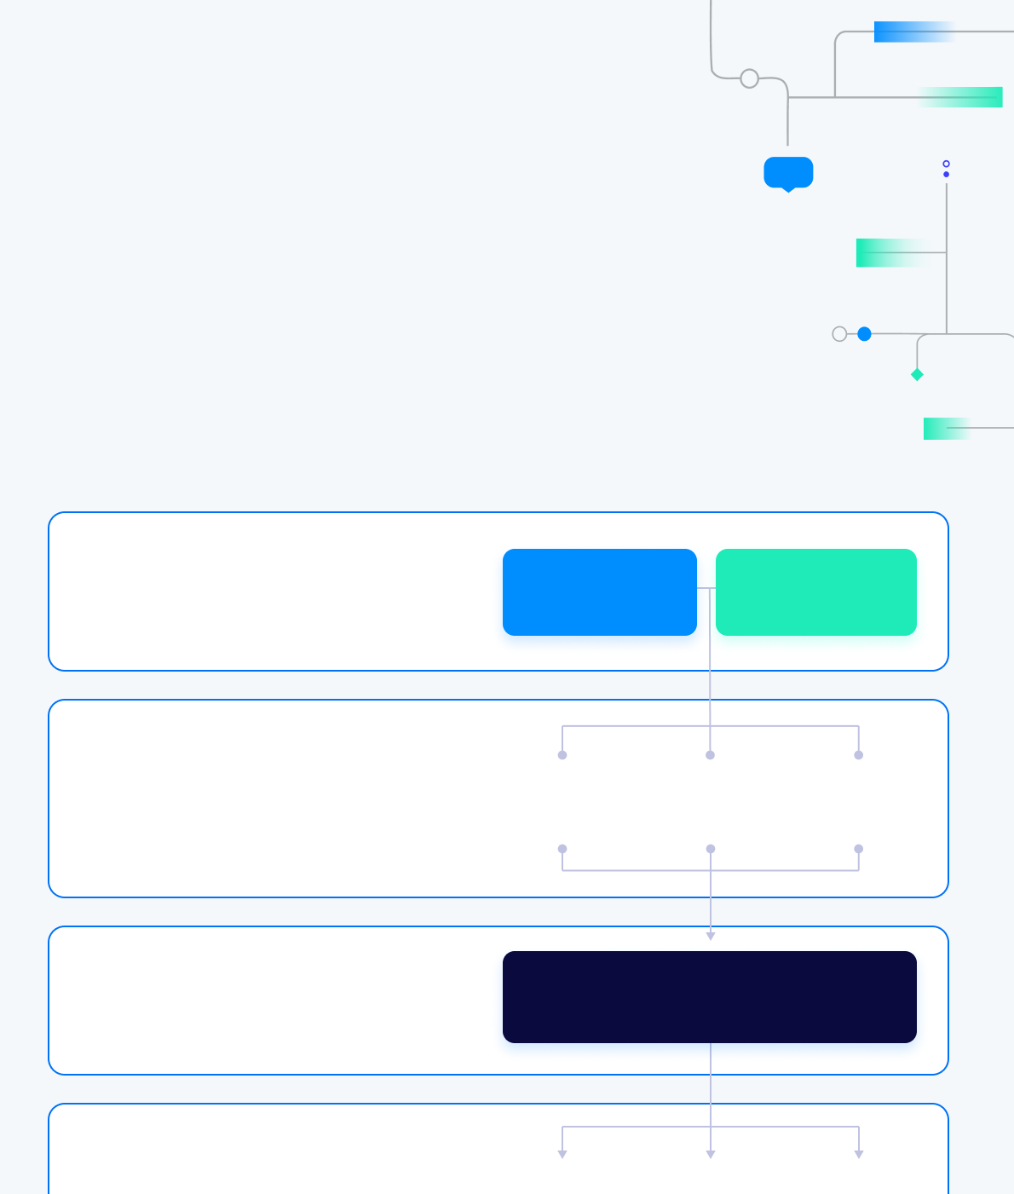
WalkMe Strategy & Value Framework - 4 P’s
Problem
Vision & Strategy
Challenges & Objectives
Possible
Why,
Who, How, When?
Do you have existing solutions?
“What If…”
WalkMe Innovation
Probable
Value Hypothesis or Assessment
Value Hypothesis or Assessment
Getting here…
Provable
Implement
Measure
Mature
Value Realization
Value Realization

Slide 3
WalkMe Strategy & Value Framework - 4 P’s
…is only achievable if we are diligent here
Problem
Vision & Strategy
Challenges & Objectives
Possible
Why,
Who, How, When?
Do you have existing solutions?
“What If…”
WalkMe Innovation
Probable
Value Hypothesis or Assessment
Value Hypothesis or Assessment
Provable
Implement
Measure
Mature
Value Realization
Value Realization

Slide 4
Value & Intake Process - Example SOP
Intake
Decision
Program Mgr.
X
✓
Not Approved (not strong enough value case)
Intake Approved
Business Case & Value Potential
Prioritization
Book of Work Planning
Project Lead
Intake & Value Discussion
Intake Requestee
Request (intake form filled out)
Intake Status & TImeline Notice
Delivery Team
Handover & Content Development SOP

Slide 5
Value & Intake Process - Example SOP with value agreements
Intake
Decision
Program Mgr.
X
✓
Not Approved (not strong enough value case)
Intake Approved
Business Case & Value Potential
Prioritization
Book of Work Planning
Project Lead
Intake & Value Discussion
Probable - What’s the potential upside if we solve the agreed-upon piece of the problem?
(Impact v. Complexity/Effort)
Benefits
Owner
Request (intake form filled out)
Intake Status & TImeline Notice
Provable
Evolves over time
Problem - What’s the issue we hope to solve? What’s the current impact of the issue? How does this problem cascade from overall strategic vision & problems?
Possible (Solution Space) - What non-WalkMe solutions are we complementing? What WalkMe solutions could we implement?
Delivery Team
Handover & Content Development

Slide 6
Example Intake Process: Stages & Ownership
Stages | Entry Criteria | Exit Criteria | Owner
Pre-Intake | -Department or stakeholder expresses interest in WalkMe -Program Manager outbound | -Intake form provided to SPOC -Key Stakeholders tab completed with as much information as possible | Program Manager & WalkMe Customer Success Manager
Intake | -Intake form submitted to Program Manager | -Intake form added to "Intake prioritization" excel sheet | Application owner/requestor
Intake Review | -Intake form added to "Intake prioritization" excel sheet | -CoE determines if request aligns with strategic objectives and will bring value to business. Determines if project should proceed. | Program Manager & WalkMe Customer Success Manager
Project Scope & Sizing | -Intake complete/accepted | -Meeting w/ team to determine scope -Update intake form with scope and size | Content Delivery Lead & WalkMe Customer Success Manager
Intake/ Project Decision | -Updated intake form | -Project approved/denied based off of resource availability | Program Manager + Program Executive Sponsor
(Ready for) Kick off | -CoE approves intake request and notifies Content Delivery Team -Project scope defined & agreed upon | -Kick off scheduled | Content Delivery Team

