Slide 1
Intake Handbook
Template
Set up-front expectations with new stakeholders on how they’ll work with the DAP delivery team.

Slide 2
Table of Contents.
The purpose of this handbook is to help you understand WalkMe, what it can do, who’s involved, how to get started, and what to expect.
Click a link below for quick access or scroll through this handbook to get a complete understanding of WalkMe:
WalkMe Offering & Essential CoE Information
Prerequisites & What to Expect
Getting Started

Slide 3
Essential Information.
Curious about WalkMe? This is what you need to know.
WalkMe Overview
Value Proposition
WalkMe Program Objectives
Scaling Model

Slide 4
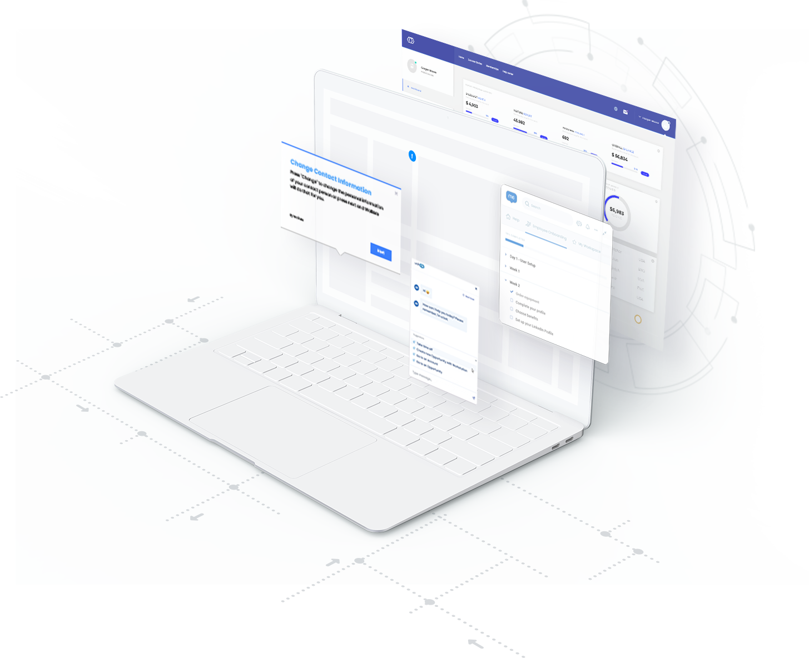
WalkMe Digital Adoption Platform Overview.
Videos
Executive Overview (2 mins)
Demo (10 mins)
Core technology
Experience (On-screen UI elements)
WalkMe’s proprietary UI intelligence driven by machine learning continuously learns and understands human interactions with any graphical user interface (GUI)
Guidance & Engagement
The touchpoint with the end user. In the form of on-screen, cross application guidance, user segmentation engagement, on screen automation, content validation and so much more.
Data
Powerful insights that allow organizations to dive into their business processes and user interactions with their technology stack.
Conversational Interface
A natural language conversational interface, that allows an intuitive and frictionless experience to extract information and complete business processes within and external to the application..
Underlying application
WalkMe is platform agnostic and can work on desktop, native mobile, or any homegrown or 3rd-party web application.
Enterprise Search
A centralized knowledge hub that pulls information across enterprise applications and knowledge resources surfacing personalized results in the flow of work..
Integrations
WalkMe’s integration center is a bi-directional data hub that allows teams to tap into their organizational data lake, segment, and drive actionable insights.

Slide 5
Total economic impact of WalkMe.
368%
<3 Month
Payback Period
$20,042,842
Present Value Benefits over 3 Years
Benefits from employee-facing apps
60%
Reduction in training time
50%
Savings in IT and Help Desk tickets
20%
Savings in software licensing fees
Benefits from customer-facing services
35%
Increase in customer retention
10%
Revenue growth from current customers
50%
Savings in customer support costs
Source: Forrester Consulting, The Total Economic Impact of WalkMe Digital Adoption Platform, October 2020 | Note: The Forrester Consulting study referred to above was based on information provided to Forrester Consulting during interviews they conducted with organizational decision-makers from four representative customers, selected by us, with experience using our Digital Adoption Platform, as well as Forrester's assumptions based on its own research. In selecting customers to participate in the study, we sought to assemble a group of customers that would provide a fulsome representation of our platform’s capabilities. As a result, we selected customers from diverse industries, each with a diverse portfolio of use cases. All customers we selected to participate in the study agreed to participate. The information provided during these customer interviews was then used by Forrester Consulting to create a modeled composite of representative customers reflecting characteristics of the interviewed organizations in order to examine the return on investment that organizations may potentially realize from deploying our Digital Adoption Platform.

Slide 6
WalkMe Program Objectives.
[Insert your company’s strategic & digital adoption objectives here]

Slide 7
Scaling Model.
Step 3.
Output
We support you.
The goal is for teams to own their WalkMe content from start to finish. The CoE and WalkMe then serve primarily as support functions for additional implementations, including customizations.
Step 2.
We do it with you.
If there is capacity on your team, we can split up content creation and other tasks.
Recommended approach for hands-on teams who want to make the time to learn the WalkMe tool. Best for long-term success.
Step 1.
We do it for you.
Upon discussing your requirements, we mock it up for you, and once you are happy with the experience, we fully implement it from build through to go-live. We then go over the build and content maintenance process with you.
Recommended approach for first implementations
Time

Slide 8
Prerequisites & What to Expect.
Prerequisites for starting an ongoing relationship with the CoE.
Prerequisites to Getting WalkMe
Identify Your WalkMe Team
Identify a Content Maintenance Owner
Strategic Alignment
Baseline & Support Metrics
Communication Structure
Active Project
Ongoing
What to Expect (From the CoE & LOB)

Slide 9
Identify Your WalkMe Team.
If you can identify these people and they have bandwidth, your project is more likely to be prioritized
Your Company’s CoE Team
You are responsible for providing these supporting roles.
Digital Adoption Program Manager
Enforces a governance model that supports scaling the program across the organization
Digital Adoption Project Manager(s)*
Adheres to governance model to execute on business cases for content delivery within scope, schedule, and budget; reports status and results to Program Manager
Digital Adoption Builder(s)*
Designs and develops WalkMe solutions; reports to/collaborates with the Project Manager
Responsible for specialized tasks on active projects.
Business Owner/Main Point of Contact
SME(s) - User Journey
SME(s) - Technical Lead
Business Analyst
Responsible in a partially or fully-dedicated capacity, for ongoing projects and maintenance.
Project Manager(s)*
Builder(s)*
*CoE will provide implementation resources for Phase 1. Department is responsible for providing implementation resources for Phases 2-N in addition to ongoing content maintenance needs. Please see Scaling Model for more information.

Slide 10
Assumptions:
1 Project = 20 deployables (50 user interactions)
1 Project = 5 use cases
1 use case = 4 deployables (10 user interactions)
Fully ramped resources
Identify Your WalkMe Team.
Role | Responsibilities | Self-Paced Training (DAI) | Content Development* | Ongoing Maintenance*
Business Owner/Main Point of Contact | Defines success criteria and ensures WalkMe content supports business objectives. Communicates the value of each engagement back to the business. | 10-15 hours | 5-8 hours per project | 2-10 hour per Q
Subject Matter Expert | Process, application, and best practice expert. Provides insights to ensure a valuable, high quality solution. |  | 15-30 hours per project | 2-15 hours per Q
Technical Lead | Coordinates IT related tasks such as deployment, defining segmentation variables, and security reviews. Understands how to deploy plugins or add snippet to the codebase. |  | 5-10 hours per app onboarding | 1 hour per Q
Business Analyst | Coordinates setup of dashboards and reporting capabilities for department to measure quantified value with internal metrics |  | 3-5 hours per project | 2-5 hours per Q
Project Manager | Primary point of contact for onboarding implementation. Ensures visibility and collaboration across all stakeholders. | 10-15 hours | 18-35 hours per project | 2-15 hours per Q
WalkMe Builder(s) | Designs, creates, and builds WalkMe content during and after onboarding. Possesses technical aptitude and interest in improving user experience. | 30-50 hours | 30-60 hours per project | 10-40 hours per Q
*time is variable based on complexity of processes, application complexity, experience level, and system release schedule.

Slide 11
Additional Prerequisites.
Content Maintenance Owner.
Strategic Alignment.
Baseline & Support Metrics.
The CoE team will help enable a member of your team with the expectation of owning the ongoing content maintenance. Training requires 50-80 hours and the ongoing maintenance time needed is based on the amount of content desired from the LOB.
Project Lead/SPOC will work with the CoE to align on strategic goals and utilizations of WalkMe to support company initiatives.
To support the value reporting to ETL by the CoE, a Business Analyst from the lines of business are expected to provide baseline and ongoing success metrics to the CoE on an ongoing basis.

Slide 12
Communication Structure (Active Project)
CoE
Department
 | Agenda | CoE Project Mgr | IS Contact | Dept Exec. Sponsor | Dept. POC | Dept. SMEs
Kickoff Call (One Meeting, 1h) | Working with CoE team TImelines & scheduling | ✓ |  | ✓ | ✓
CoE PM/Department PM Syncs (Weekly, 15-30m) | Scope alignment/Scope change alignment Risk log review/risk management Timeline updates/escalations | ✓ |  |  | ✓
Value Assessment Call(s) (One to Two Meetings, 30m/e) | Identifying how impact will be measured | ✓ |  | ✓ | ✓
Problem Discovery Call(s) (One to Two Meetings, 1h/e) | Discussion of status quo problems requiring WalkMe implementation | ✓ | ✓ |  | ✓ | ✓
Solutioning Calls (Weekly, 1hr, As-Needed) | CoE contact reviews solutions and asks additional process questions | ✓ | ✓ |  | ✓ | ✓
Final Review (One to Two Meetings, 1h/e) | Full review of content phase + Live feedback | ✓ |  | ✓ | ✓
Analytics Review (One Meeting, 30m) | Alignment on how to track engagement (Reports, KPI’s) | ✓ |  | ✓ | ✓
Debrief & Next Steps Weekly (1hr/app) | Revisiting objectives and value story Successes and lessons learned Prospective next projects with CoE | ✓ |  | ✓ | ✓

Slide 13
Operating Model (Ongoing)
CoE
Department
 | Agenda | CoE Program Mgr | CoE Project Mgr | IS/IT | Dept Exec. Sponsor | Dept. POC | SMEs
Strategic Planning Yearly (2hrs) | Dept. Strategic planning (Same as above)- with each dept | ✓ |  |  | ✓ | ✓
Operational Business Review Quarterly (1hr) | Review progress (value) from previous qtr Realign on strategy and focus for following qtr Review impact of live content (per app/project/process) | ✓ | ✓ |  |  | ✓
Operational Meetings (1hr) | Monthly: Prioritize ad hoc requests/intake | ✓ |  |  |  | ✓ as needed
 | Monthly: Status update on active projects | ✓ |  | ✓ |  | ✓ | ✓
An initial implementation of WalkMe for your Business Unit/Application spurs conversation around more use-cases. This is the start of a relationship between you and the WalkMe Center of Excellence - get excited for all the value to be had!

Slide 14
What to Expect
From the CoE
From the LOB
Centralized Budget
There is no licensing cost for implementing WalkMe on employee-facing systems as it is covered in the enterprise license agreement.
Center of Excellence Support
We have a dedicated CoE team to help develop content and/or enable you or a member of your team.
Measure Progress & Success
To ensure the investment of resources and time is returned, the CoE will roll up value reporting from the LOBs into a comprehensive summary for ELT.
Strategic Alignment
Application (SME alignment..) will work with the CoE to align on strategic goals and utilizations of WalkMe to support company initiative.
Content Maintenance
The CoE team will help enable a member of your team with the expectation of owning the ongoing content maintenance. Training requires 50-80 hours and the ongoing maintenance time needed is based on the amount of content desired from the LOB.
Baseline & Success Metrics
To support the value reporting to ETL by the CoE, lines of business are expected to provide baseline and ongoing success metrics to the CoE on an ongoing basis.

Slide 15
Getting Started.
Tactical steps to start the WalkMe journey.
Steps to Request WalkMe
Intake Follow-up Process
Self-Service Resources

Slide 16
Steps to Request WalkMe
YOU ARE HERE
1
2
3
Gather Requirements
Align department priorities to technology and business outcomes
Pull baseline data to quantify the pain points
Identify Solution Builder and Maintainer
Intake Request
Fill in the Intake Request Form
[Add company-specific information here]
Scope of Work
With CoE:
Quantify value potential if goals are achieved
Demo the business process or pain points for content delivery effort estimation
CoE creates the following with you for signoff:
Business case
Value Potential
Project Kickoff
Timeline Setting
Solution Discovery
Content creation
QA/Testing
Go-Live

Slide 17
Intake Follow-Up Process
[Add your company’s intake follow-up process here]

Slide 18
Self-Service Resources
[Add your company’s self-service resources here -- e.g. knowledge pages, WalkMe DAI, implementation handbook, office hours, etc.]

Slide 19
Appendix
Sample Value Story Templates.

Slide 20
Example Value Story.
The Problem:
The Business Impact:
After onboarding, the Support Team is the go-to for all questions. However, Tier 1 how-to support tickets took critical time away from higher impact tickets and often resulted in missed SLAs. Prior to WalkMe, how-to support tickets averaged nearly 1,800 tickets a month (~80% of all Tier 1 tickets).
$144,000 support savings
5,280 ticket reduction * 20 mins AHT * $80/hrs
4% NPS improvement
2% decrease in Average Reply Time (ART)
WalkMe Solutions:
Solution Outcomes:
13
19
45
12
7
28
SmartTip Set
250K
200K
150K
100K
50K
0K
2,000
1,500
1,000
500
0
Launchers
Smart WalkThrus
System new feature release
ShoutOuts
# WalkMe Engagements
# How-To
Support Tickets
Onboarding Tasks
Resources
Go-Live
Month 1
Month 2
Month 3
Month 4
# WalkMe Engagements
# How-To Support Tickets

Slide 21
Example Value Story.
Note: Consider limited Executive time (and starting off with a bang) to roll up value by use case or application for a quick high-level glance.
Total $ Benefit
$2.1M
Goal | Metrics | Cash Impact
Reduce support tickets for simple how-to questions | Reduced Level 1 tickets by 20,000 over one year | $400,000 support cost avoidance per year
Reduces change management cost for transition from Classic to Lightning | Reduced training from 70 to 30 minutes | $1.35M training cost avoidance
Improve data integrity & reduce close time: currently data issues are resulting in additional rework time & extended close time | Reduced average close time by 2.3 days | $350,000 rework cost avoidance

Slide 22
Example Value Story.
CHALLENGE
Large new system rollout
Company offices and in-person trainings closed due to COVID
Change management is time intensive and additionally complicated with a variety of time zones, languages, and ADA requirements
SOLUTION
250 WalkThrus to guide users through 100+ processes across multiple platforms
Search integration with access to all of the existing procedure guides that had previously been difficult to locate
All content made available in 12 languages in mobile and web
ADA compliant
RESULTS
Seamlessly onboarded 150K+ employees to a new system
Eliminated the need for change management training sessions (estimated 375K hours deflected)
87.2% of users accessing WalkMe to complete business critical processes in the first week post Go-Live
Great employee feedback, especially for non-native english speakers to be able to choose their preferred language
Notes:
Tactical Example: Share how we combined help desk data with WalkMe insights

