Slide 1
Common DAP
use cases.
Slides for discussing use cases with your team, leadership, or other departments

Slide 2
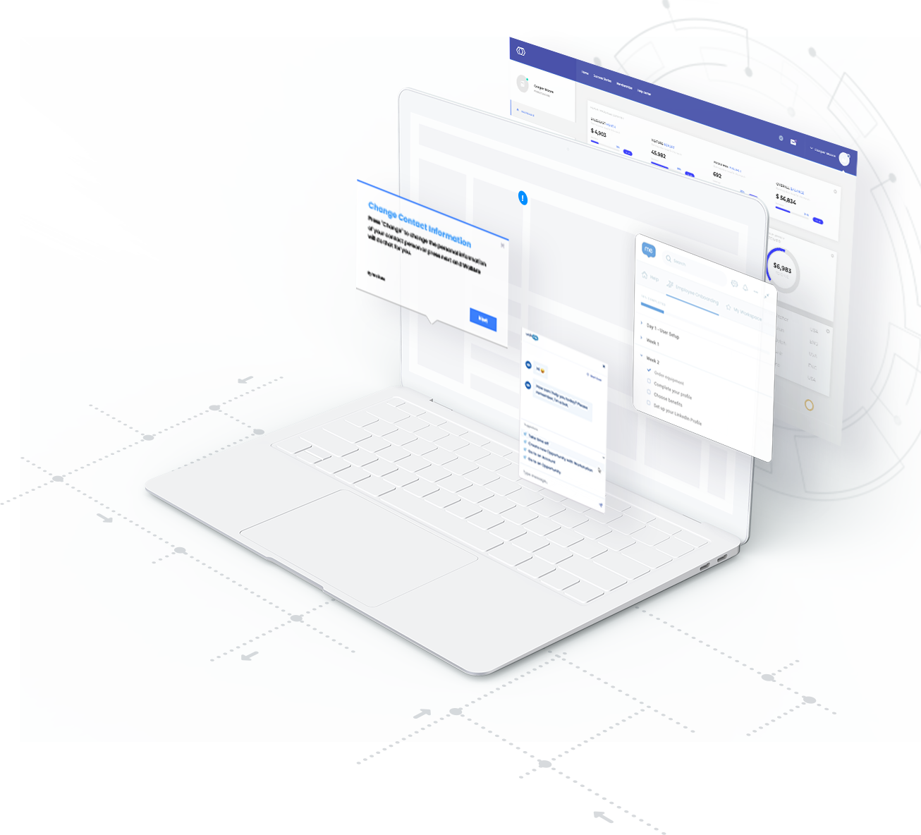
Contents
1
Enforce data integrity
Improve quality and completeness of information
2
Adopt new technology
Drive effective and valuable use of technology
3
Manage change
Roll out changes quickly and smoothly
Increase employee productivity & satisfaction
Improve ability of employees to navigate and use various apps and tools
4

Slide 3
Outcome: Enforce data integrity
Improve quality and completeness of information
Information accuracy
Information completeness
Input validation
Selection guidance
Dynamic field help
Form templates

Slide 4
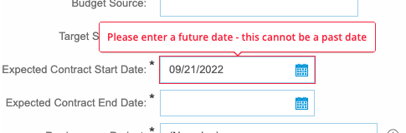
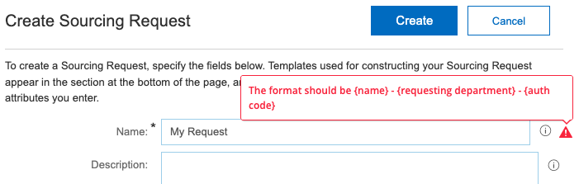
Use case: Input validation
Validate that field-level data has been entered correctly. (Did the user follow a naming convention that’s integral to business objectives or specific to your organization?)
Alert the user when data entered is invalid or will have specific consequences if left unchanged.
Information accuracy
WalkMe features
SmartTips with Validation
Value
Enforce data integrity standards across the organization.
Ensure consistency of data across business units for more accurate reporting.
Enforce data integrity

Slide 5
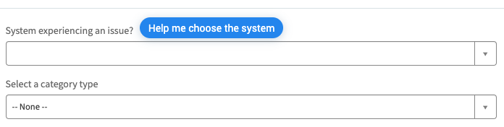
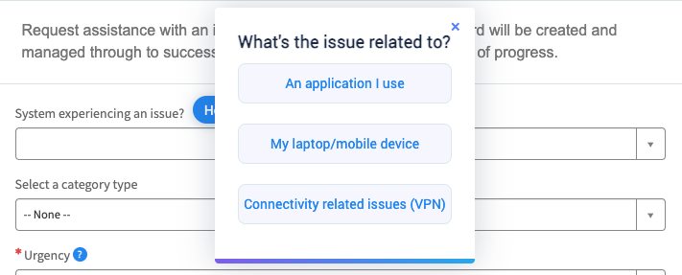
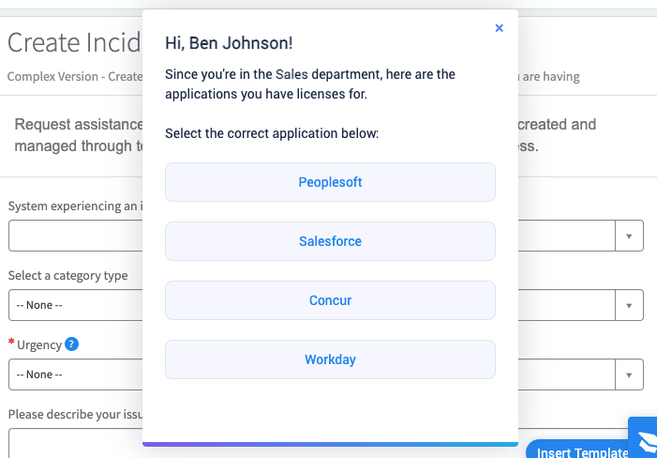
Use case: Selection guidance
Offer assistance with complex forms or processes where end-users are faced with multiple selections.
There are negative implications when an incorrect selection is made.
Information accuracy
WalkMe features
1
Smart Walk-Thrus with branching
2
Value
Improve the accuracy of provided input.
Reduce error that lead to Support tickets due to users not understanding the field options.
Save employees time searching for answers.
3
Enforce data integrity

Slide 6
Use case: Dynamic field help
Requirements change dynamically based on record type or selection made, and users need to remember which information to enter in each scenario.
Information completeness
WalkMe features
SmartTips
Value
Ensure that all records are filled out correctly with no critical information missing.
Enforce data integrity

Slide 7
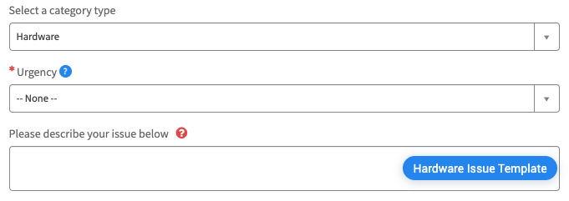
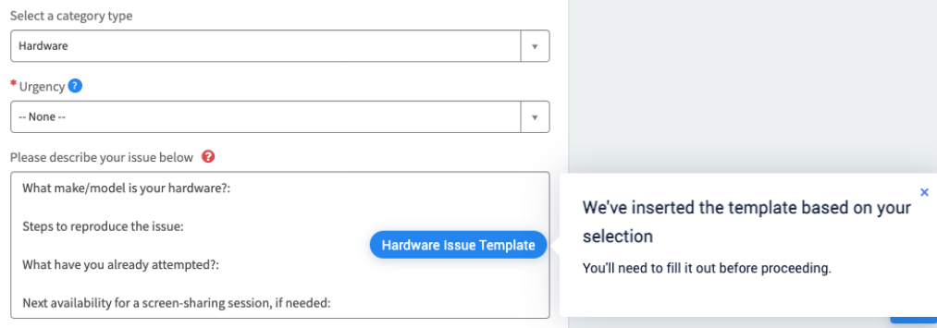
Use case: Form templates
You need to add structure to otherwise unstructured fields, like where free text is required.
Input requirements change based on preceding user actions or selections.
Information completeness
WalkMe features
Smart Walk-Thrus with automation
1
Value
Prevent the input of unusable or irrelevant information due to a lack of structure.
Save time for end-users.
Foster robust information collection without adding more fields.
2
Enforce data integrity

Slide 8
Outcome: Adopt new technology
Drive effective and valuable use of technology
Feature utilization
App value awareness
User action required
Targeted reminder
Track usage
In-app feedback loop
Timely call to action
Cross-app reminder

Slide 9
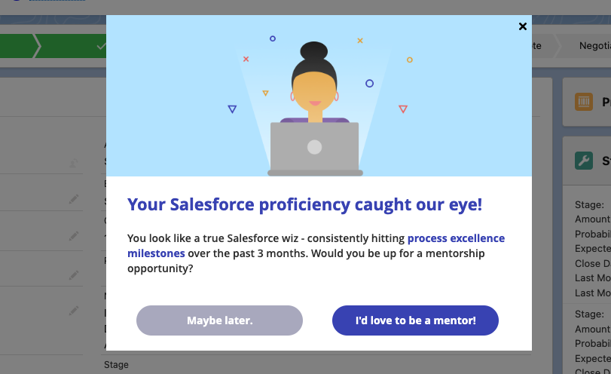
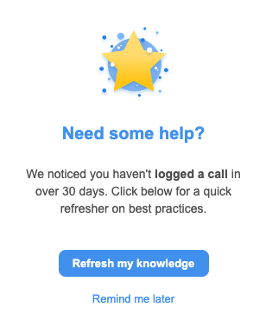
Use case: Targeted reminder
Drive ongoing adoption of existing underutilized features.
Create tailored engagement based on a particular user’s past activity (or lack of activity).
Respond to user behaviors both instantly and over time.
Feature utilization
WalkMe features
ShoutOuts
Smart Walk-Thrus
Value
Maximize the technology value delivered to your end-users.
Drive adherence to best practices.
Increase utilization of full range of application value.
Boost the application experience.
Adopt new technology

Slide 10
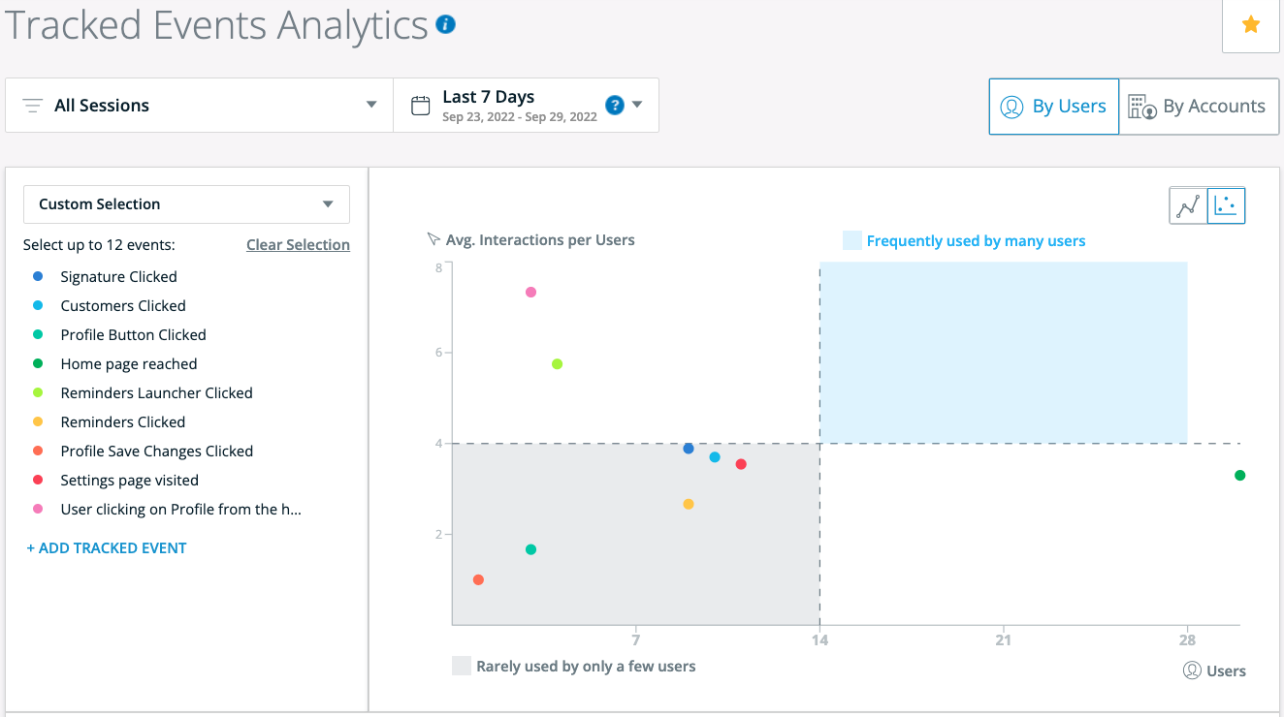
Use case: Track usage
Track usage of various features and functions.
Understand how and where employees interact with a given app.
Review usage metrics based on user attributes (role, location, etc.).
Feature utilization
WalkMe features
Insights Tracked Events
Value
Collect sophisticated usage analytics.
Identify opportunities to improve feature awareness and usage.
Adopt new technology

Slide 11
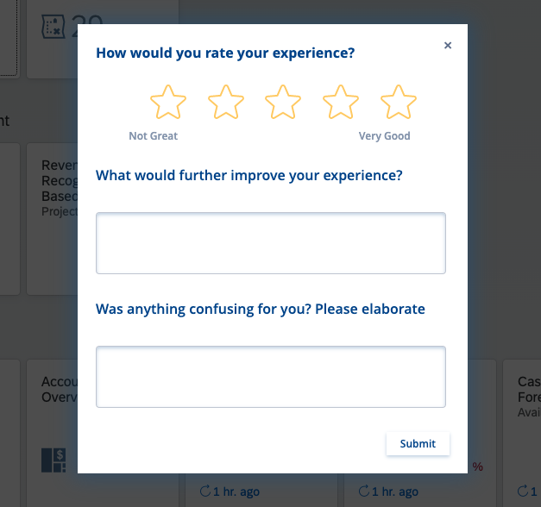
Use case: In-app feedback loop
Gather feedback on users’ experiences within a given application.
Target user segments with customized content based on response data.
App value awareness
WalkMe features
Surveys
ShoutOuts
Value
Maximize responses by engaging users in the flow of work, when they’re most likely to provide feedback.
Improve application adoption by targeting users based on specific needs.
Understand employee sentiment.
Adopt new technology

Slide 12
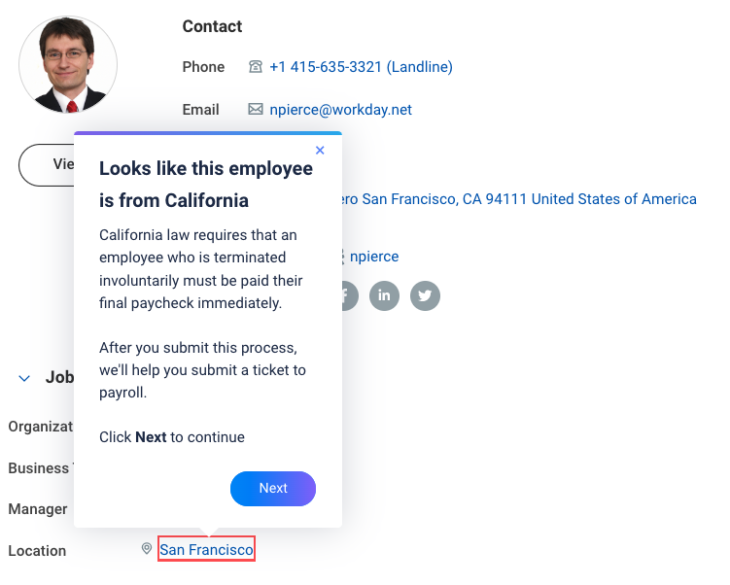
Use case: Timely call to action
When a user takes a specific action or task, they often forget to take a required/important follow-up action.
When X is selected, I need users to do Y or there are errors that need correcting.
User action required
WalkMe features
Smart Walk-Thrus
ShoutOuts
Value
Ensure users complete critical processes correctly the first time.
Reduce the need to manually follow up with users or complete processes on their behalf.
Adopt new technology

Slide 13
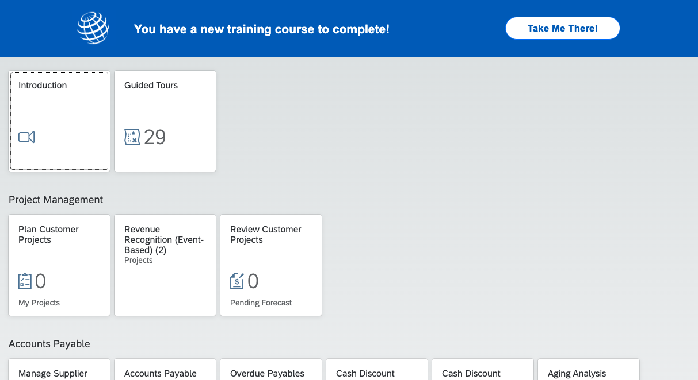
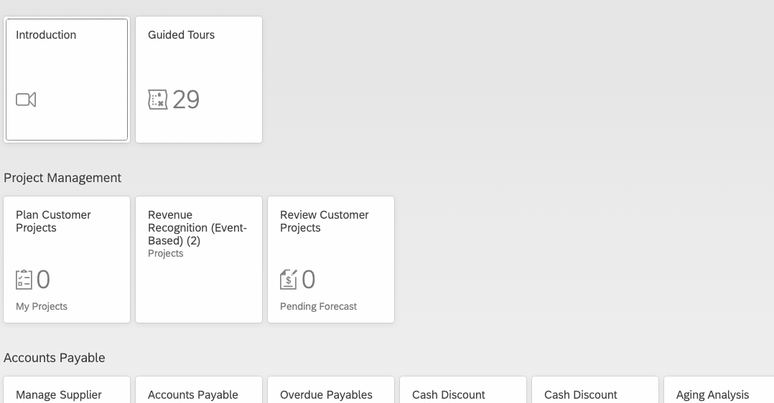
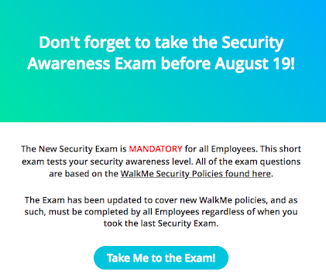
Use case: Cross-app reminder
Users are required to take a certain action or complete a certain task.
There is an upcoming deadline, and not all users have yet met the relevant requirements.
Notifications within the given application are not effective enough because users don’t regularly log into this tool.
User action required
WalkMe features
ShoutOuts
Launchers
Value
Maximize on-time participation in company initiatives (annual security awareness training, expense report submission)
Reduce need to manually follow up with specific users who have outstanding required tasks
Adopt new technology

Slide 14
Outcome: Manage change
Roll out changes quickly and smoothly
Enforce policy changes
New process or app rollout
Partial process change
Compliance warnings
Update notifications
Application redirect
Field-level change
Contextual process guidance

Slide 15
Use case: Compliance warnings
Remind users of critical policies right at the time of relevance.
Respond to a specific user action or lack of action, right as it happens.
Track user acknowledgement of warning messages.
Enforce policy changes
WalkMe features
User tries to click the Submit button
Invisible Launchers
1
Smart Walk-Thrus
Value
User sees an in-app warning before they can proceed
Reduce risk of non-compliance.
Create a referenceable audit record of user policy acknowledgement
Secure employee awareness of key changes.
2
Manage change

Slide 16
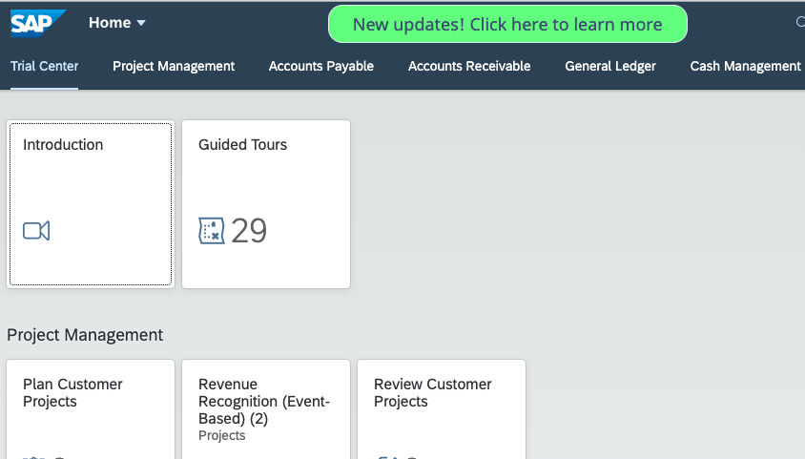
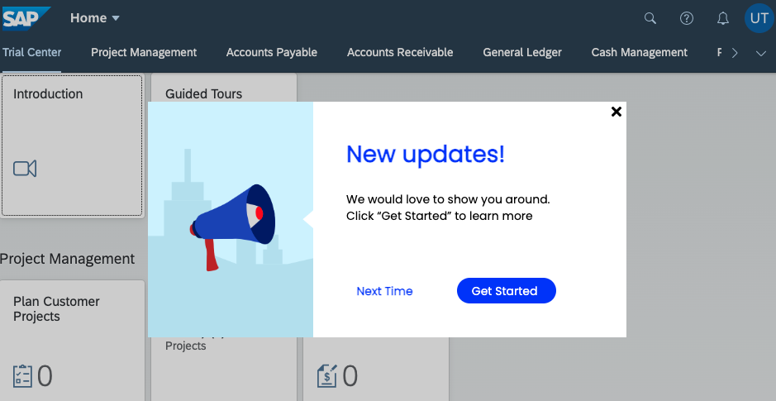
Use case: Update notifications
Notify end-users when there are newly added features.
Share updates with users right at the moment of relevance.
Drive usage of newly added/developed features.
New process or app rollout
WalkMe features
Launchers
ShoutOuts
Value
Increase employee adoption of critical or helpful application enhancements.
Decrease reliance on webinars or email communication.
Minimize user confusion when changes are made.
Manage change

Slide 17
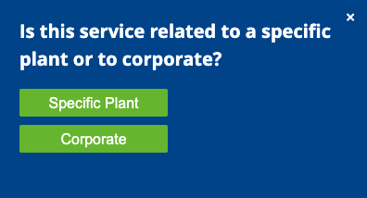
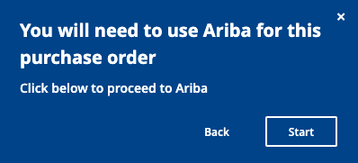
Use case: Application redirect
You’ve migrated or partially migrated processes to other applications, but the previous application is still active.
You’re migrating workflows in phases.
Users are accustomed to doing things a certain way; enforcing the process change will need to happen on an ongoing basis.
New process or app rollout
WalkMe features
User tries to begin process in app 1
WalkMe automatically prompts user with a warning, followed by directions to app 2
Smart Walk-Thrus
1
2
ShoutOuts
Value
Enable employees to navigate a complex tech ecosystem.
Streamline adoption of new changes.
Minimize the risk of data being put into the wrong system.
Manage change

Slide 18
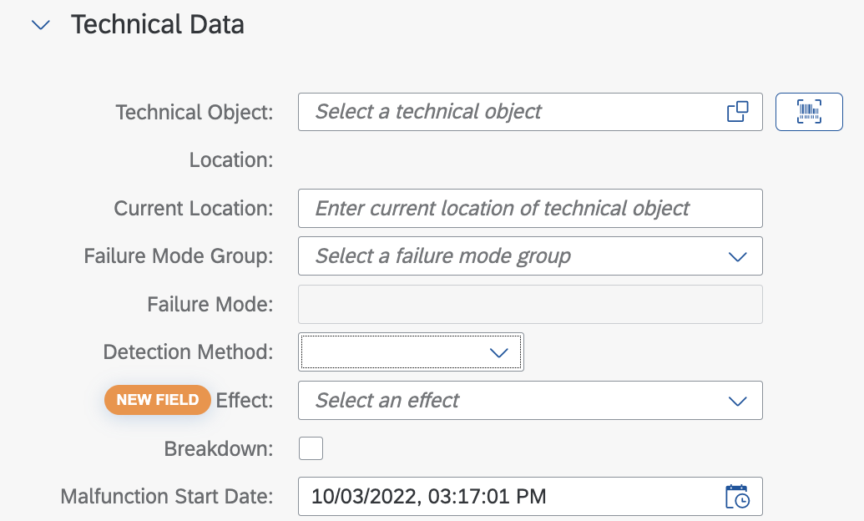
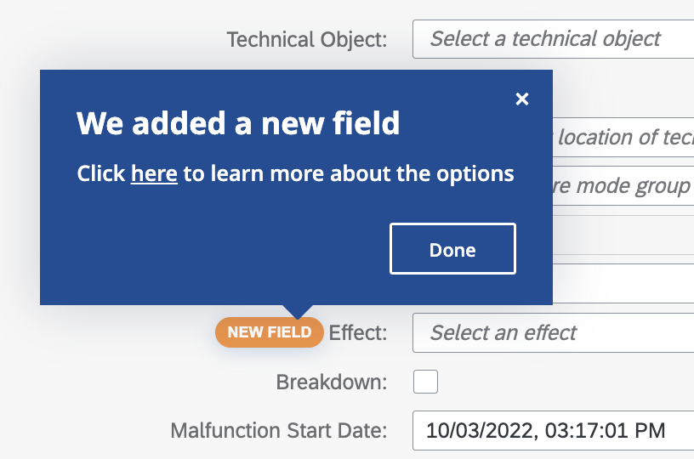
Use case: Field-level change
A change was implemented for a single form field (options in drop-down menu were renamed or new format requirements were put in place).
A small update was made to a form that is used very infrequently.
Partial process change
WalkMe features
Launchers
SmartTips
Value
Drive change awareness right at the moment of relevance.
Minimize confusion and frustration for users.
Decrease opportunity for error, escalation, or incorrect data entry.
Manage change

Slide 19
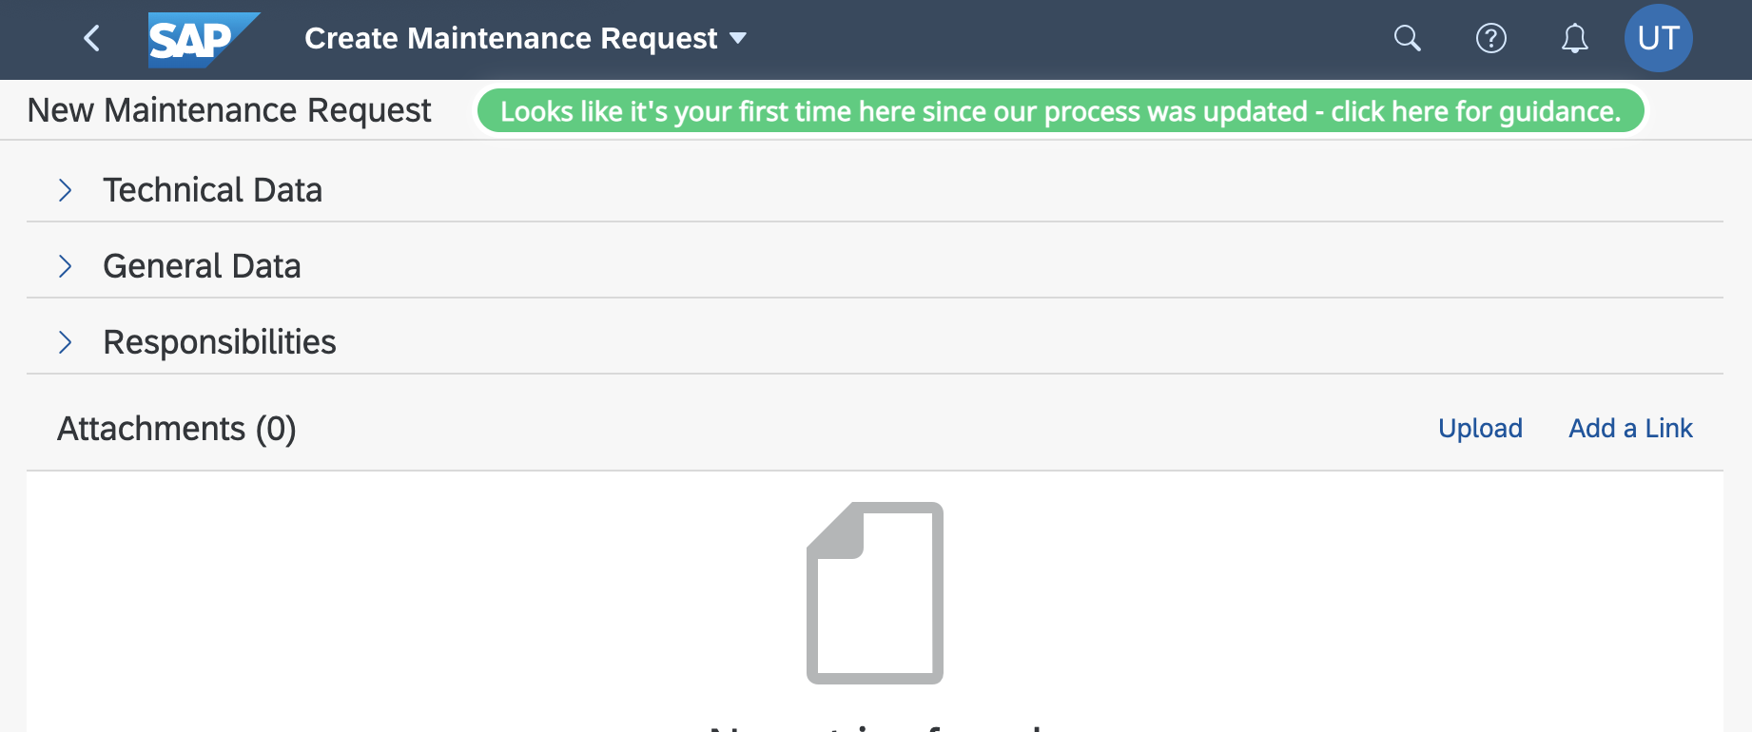
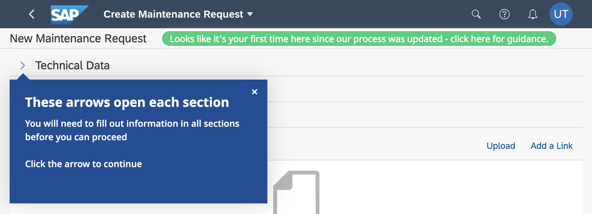
Use case: Contextual process guidance
Proactively guide users through new best practices when rolling out a process change.
Offer workflow guidance the first time a user engages with the update, no matter how long ago that update was implemented.
Partial process change
WalkMe features
Smart Walk-Thrus
ShoutOuts
Launchers
Value
Streamline adoption of new changes.
Reduce user frustration associated with changes.
Reduce time employees spend in training.
Manage change

Slide 20
Outcome: Increase employee productivity & satisfaction
Improve the ability of employees to navigate and use various apps and tools
Reduce process completion time
Reduce time to competency
Decrease how-to tickets
Improve employee experience
Embed resources
Automate tasks
Copy-Paste
Onboarding checklist
Process guidance
Conditional steps
Prerequisites check
Automation assistance

Slide 21
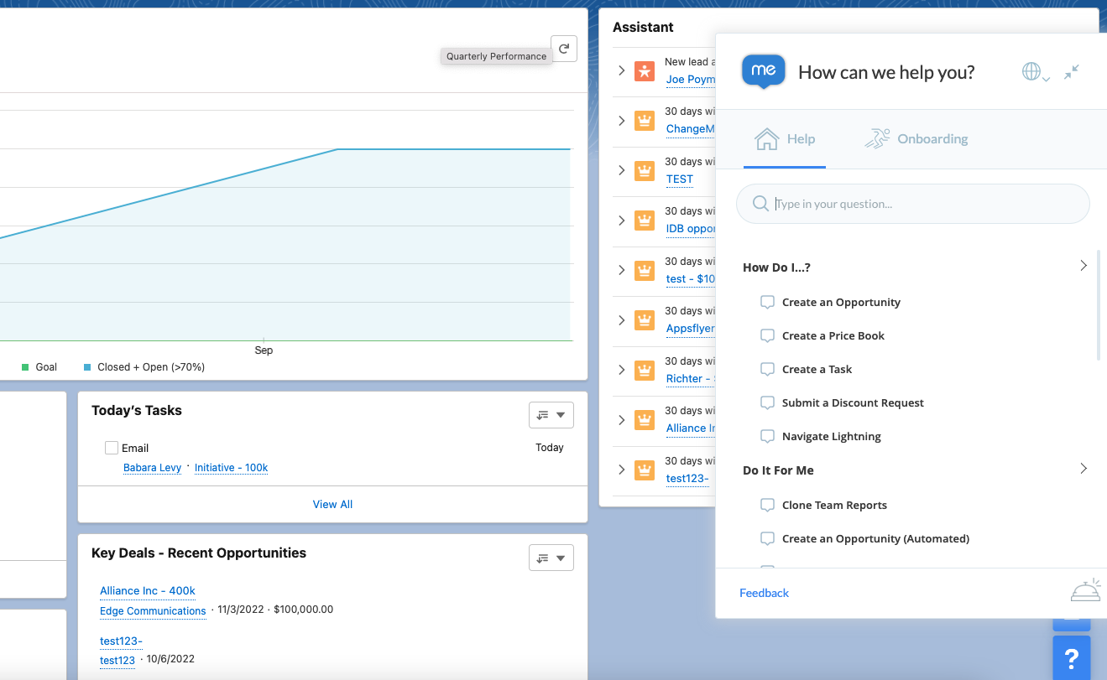
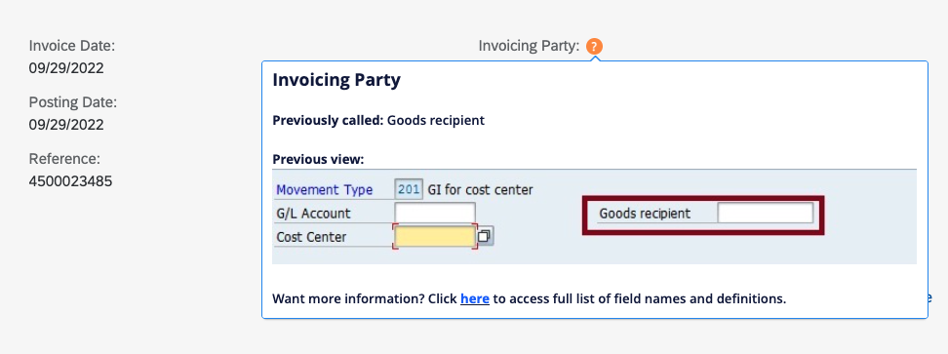
Use case: Embed resources
Bring your reference information into your application, streamlining access to relevant help materials (videos, KB articles).
Offer users the ability to search and find information without leaving the app where they are working.
Reduce process completion time
WalkMe features
SmartTips
Menus
Value
Reduce time spent searching for information.
Reduce time spent completing a task.
Reduce call resolution times.
Increase employee productivity & satisfaction

Slide 22
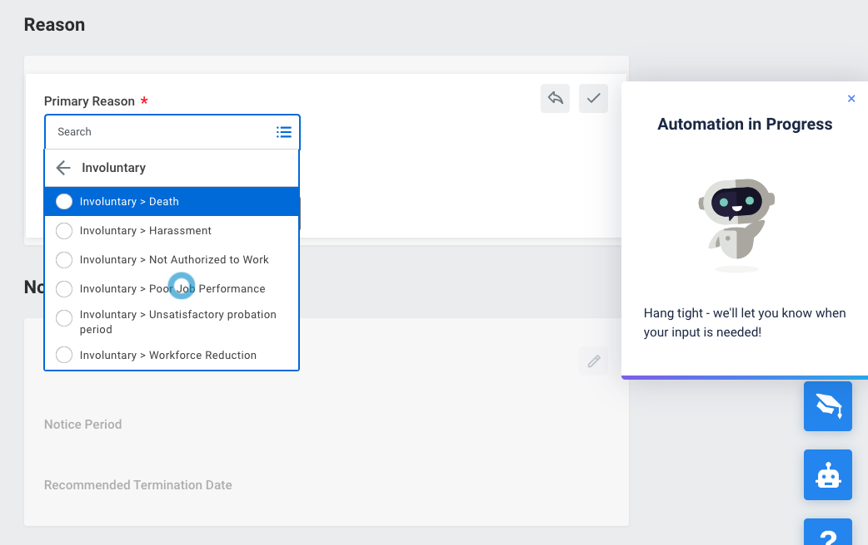
Use case: Automate tasks
Substantial parts of process are redundant and time-consuming.
There are tasks that users need to complete only once or very infrequently, and they therefore need to relearn the process and requirements every time.
Reduce process completion time
WalkMe features
Smart Walk-Thrus with automation
ActionBot
Value
Auto-click shown on screen with ripple effect
Reduce empty clicks.
Minimize time spent training and retraining employees.
Drive employee efficiency by collecting all necessary inputs for task completion from a single chat interface.
Improve % of employees who complete tasks.
Increase employee productivity & satisfaction

Slide 23
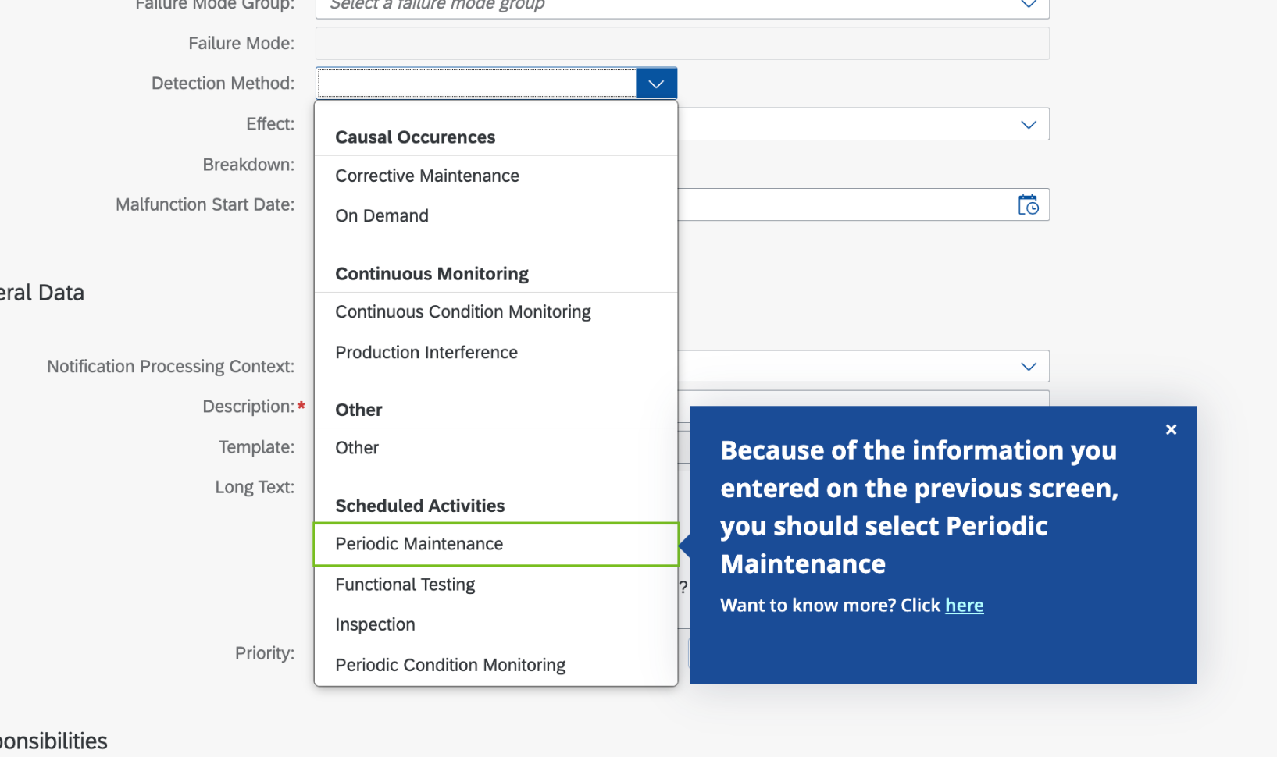
Use case: Copy-paste
During a process, there is information used/entered in one part of the workflow, which needs to be re-entered/referenced at a later point.
Depending on information entered/selected, process requirements may change.
Reduce process completion time
WalkMe features
Smart Walk-Thrus with automation
Value
Reduce user frustration that may come from entering information incorrectly or forgetting details and having to go back.
Improve data accuracy.
Drive employee efficiency.
Increase employee productivity & satisfaction

Slide 24
Use case: Onboarding checklist
Users need system training in order to complete key job functions.
A new system is rolled out, requiring employees to acquire proficiency with it.
Upon first use an application, users need to complete a series of setup steps and/or learn some key workflows.
Training varies by user role, position, location, etc.
Reduce time to competency
WalkMe features
Onboarding
Value
Improve onboarding speed.
Reduce time employees spend in training.
Task completion is reflected in the user’s in-app menu and in WalkMe Insights
Increase employee productivity & satisfaction

Slide 25
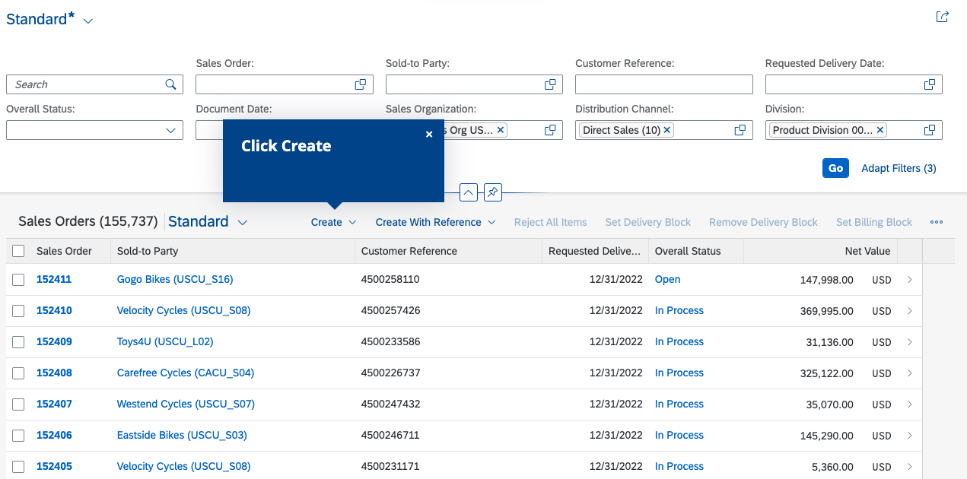
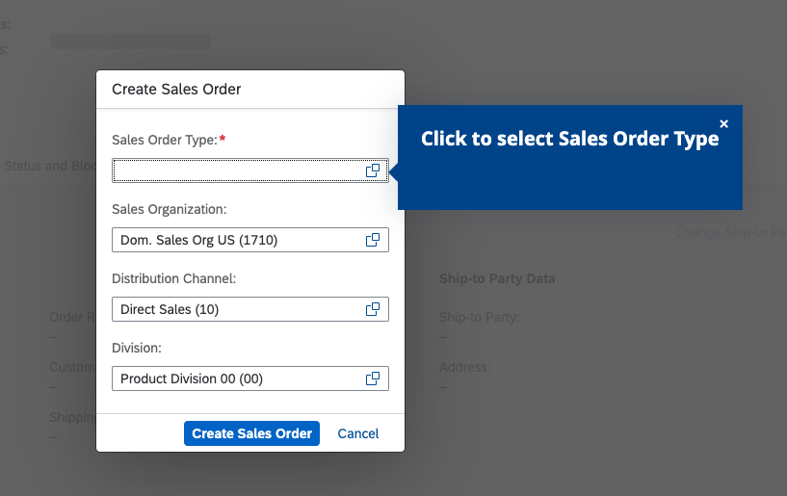
Use case: Process guidance
Proactively guide users through every step in a process with explicit instructions.
Show users where to go and what to enter, within and across applications.
Mimic live, expert assistance.
Reduce how-to tickets
WalkMe features
Smart Walk-Thrus
Value
Drive user self-sufficiency.
Reduce escalations.
Drive adherence to company best practices.
Improve resolution time.
Increase employee productivity & satisfaction

Slide 26
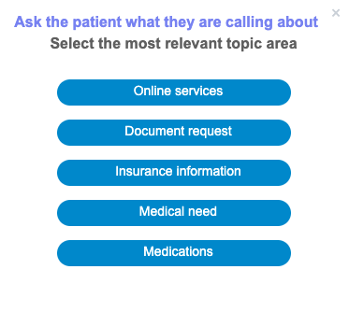
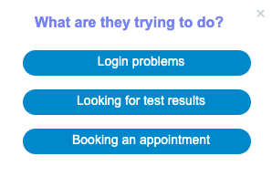
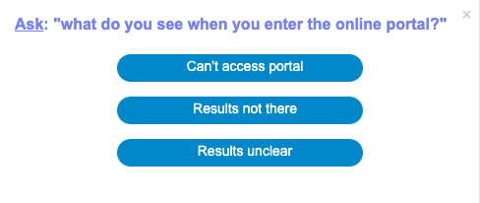
Use case: Conditional steps
A process can go in many directions depending on the action a user takes.
Traditional documentation requires “if this, then that” logic.
Improve employee experience
WalkMe features
1
Smart Walk-Thrus with branching
2
Value
Drive process adherence, no matter the complexity of workflow.
Minimize user frustration.
Improve employee efficiency.
3
Increase employee productivity & satisfaction

Slide 27
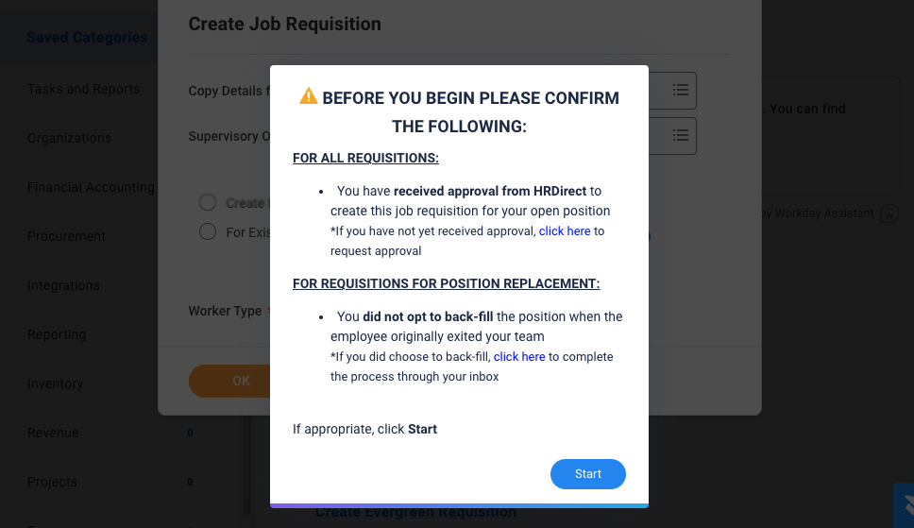
Use case: Prerequisites check
A process requires that certain criteria be met in order for a user to proceed.
Requirements for a process are not systematically enforced, so ineligible users submit unauthorized information.
Certain requirements are not enforced or requested until the end of the process, causing users to waste time filling out the requested information, only to find out at the end that they are unable to complete the process.
Improve employee experience
WalkMe features
ShoutOuts
Value
Reduce manual deletion or correction of data.
Minimize user frustration.
Save employees from wasted time and effort.
Increase employee productivity & satisfaction

Slide 28
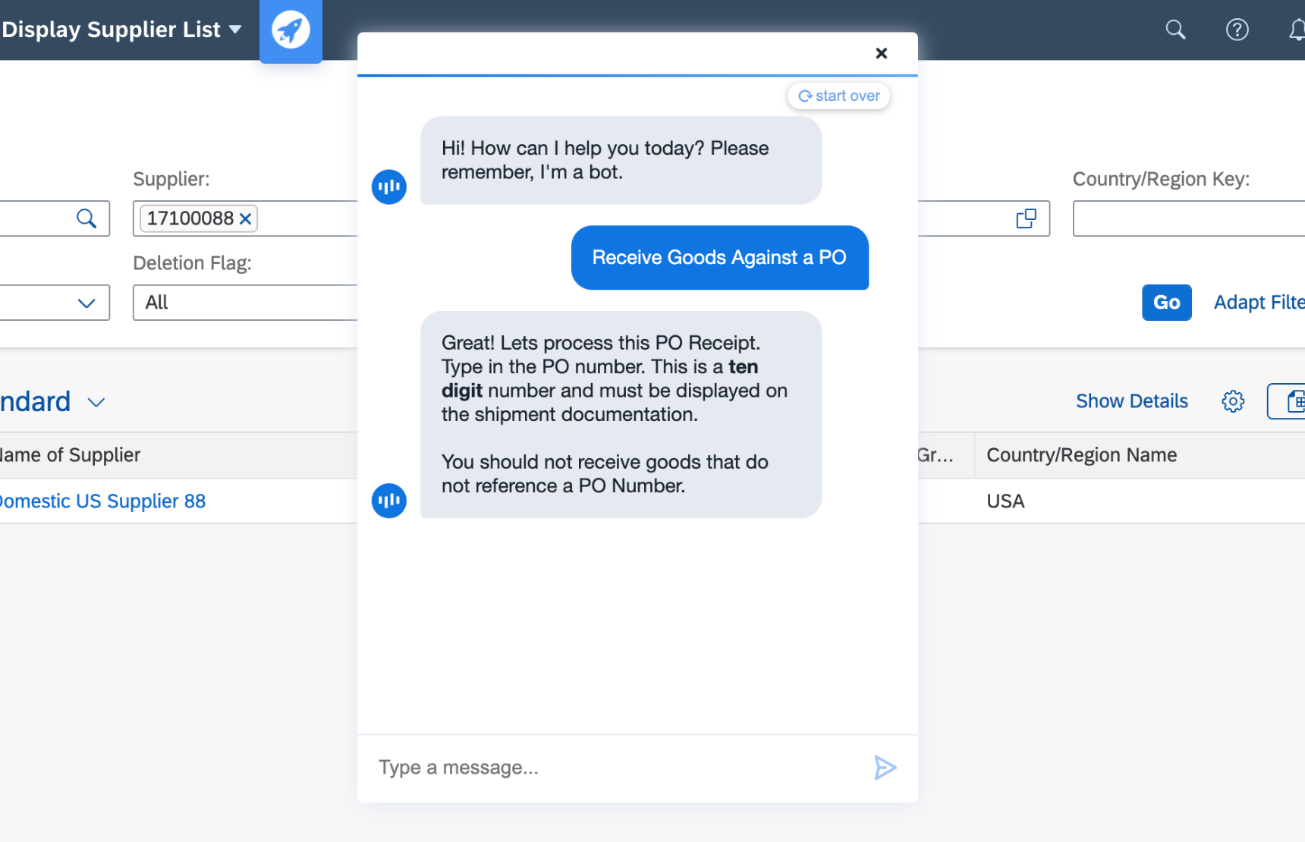
Use case: Automation assistance
Employees are not completing required system entries or tasks.
Users are working with new or unfamiliar technology.
The number of steps to remember/click through leads to user frustration and process abandonment.
There are an overwhelming number of fields, but only a few are required.
Improve employee experience
WalkMe features
ActionBot
Value
Reduce time employees spend completing tasks.
Increase likelihood that employees use applications as intended.
Minimize user frustration.
Improve on-time and accurate completion of processes.
Increase employee productivity & satisfaction

